Slide 1
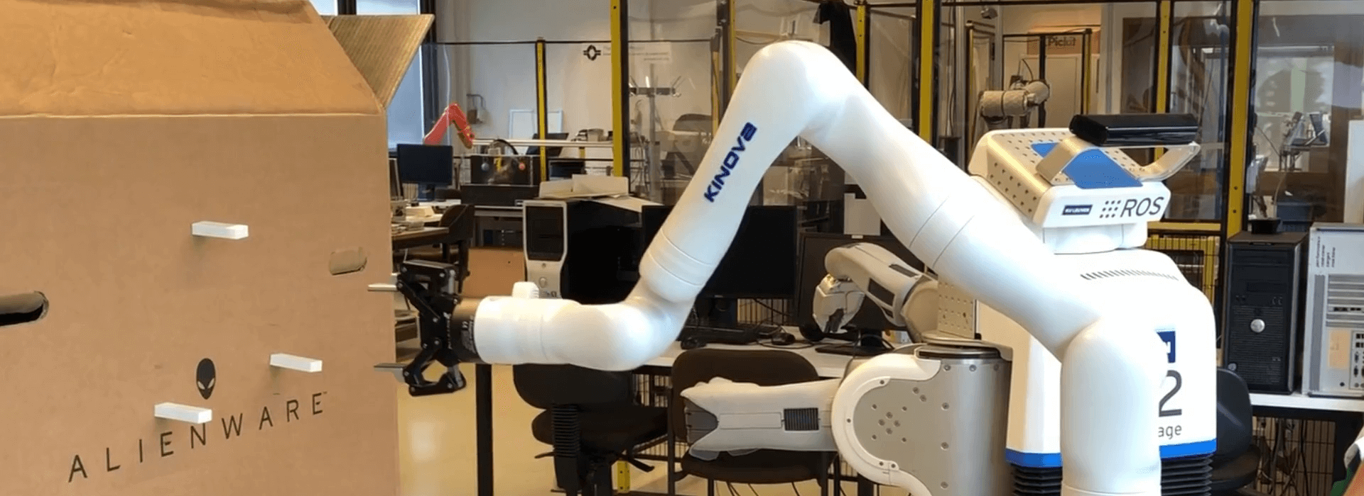
Telemanipulator Robot
Robotic Hardware System
Mohamad Luqman Idlan bin Mohamad Azahari
1723539

Slide 2
Main Components
1. Design
2. Propulsion/Driving System
3. Data Collection
4. Data Transmission
5. Navigation and Control System
6. Power Management

Slide 3
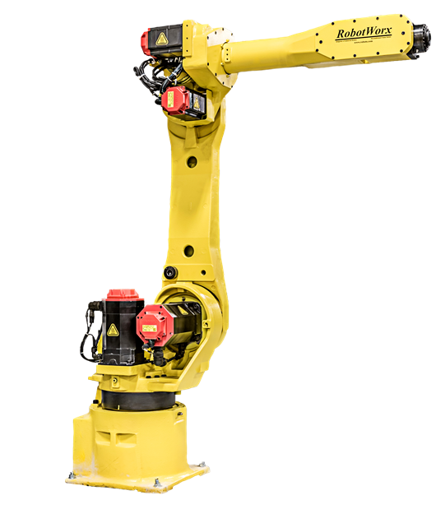
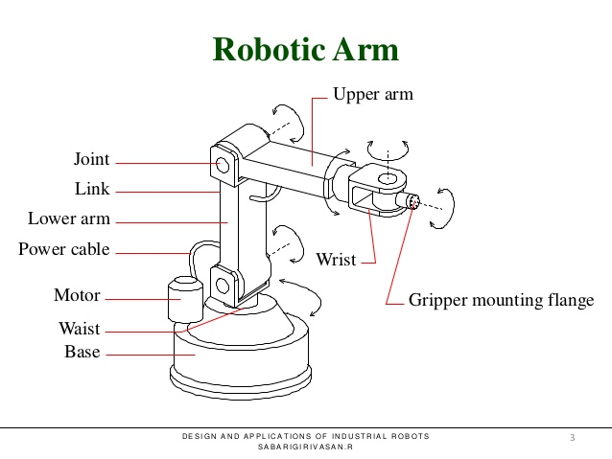
Design
Gantry Robots
These robots have linear joints and are mounted overhead. They are also called Cartesian and rectilinear robots.
Cylindrical Robots
cylindrical anatomy robots are fashioned from linear joints that connect to a rotary base joint.
Robot Wrist
The wrist is used to orient the parts or tools at the work location.
Jointed-Arm Robots
The arm connects with a twisting joint, and the links within it are connected with rotary joints. It is also called an articulated robot.
Polar Robots
The base joint of a polar robot allows for twisting and the joints are a combination of rotary and linear types.
Types of manipulators

Slide 4
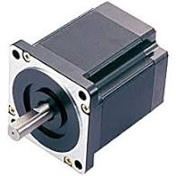
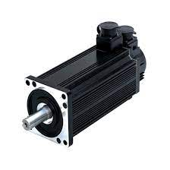
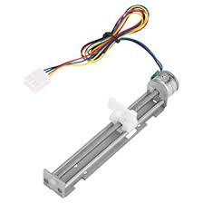
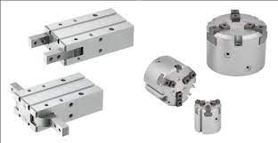
Propulsion/Driving System
1. DC stepper motor
2. Slider and stepper
3. DC servo motor
4. Pneumatic Gripper

Slide 5
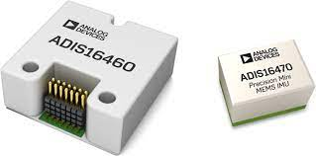
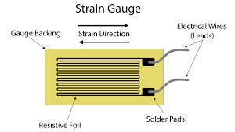
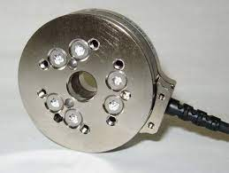
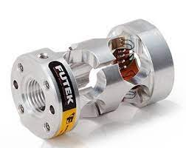
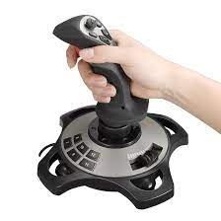
Navigation system
1. Inertial Sensor- to find acceleration of the end effector
2. Strain gauge sensor-to measure force
3. F/T sensor-to monitor linear and rotational forces
4. Torque Sensor- to detect torque
5. Joy stick

Slide 6
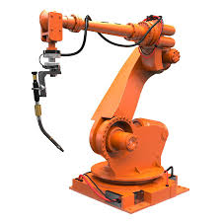
Data Collection and Transmission
operator’s console
industrial computer
motion controller
expansion boards
peripheral devices
power modules

Slide 7
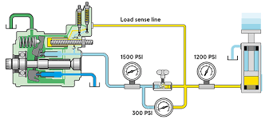
Power Management
1. AC power supply
2. Air and hydraulic supplies

